Slide 1
Evaluating a Network’s Performance

Slide 2
What are the important performance metrics for networks?

Slide 3
Latency, Throughput, and Errors
We’ll discuss three performance metrics in this module
Latency: how long it takes for data to reach its destination
Throughput: how much data can be sent over a given amount of time
Errors: does the data arrive in a usable manner?

Slide 4
What causes latency in a network? Think about everything that takes time when communicating data.

Slide 5
What causes latency?
Latency is the delay between when data is sent and received
Four sources of latency in the network
Transmission/Bandwidth delay
Propagation delay
Processing/Store-and-forward delay
Queuing delay

Slide 6
What causes latency?
Four sources of latency in the network
Transmission/Bandwidth delay
Propagation delay
Processing/Store-and-forward delay
Queuing delay
Total latency equals the sum of these components
d_{total} = d_{trans} + d_{prop} + d_{process} + d_{queue}

Slide 7
Sources of Delay
Your Computer
Router
P1

Slide 8
Sources of Delay: Transmission Delay
Your Computer
Router
P1
Transmission (or bandwidth) delay is the time required to transmit a packet onto the “wire”
Packet size measured in bytes (e.g. 64 kB)
Transmission rate measured in bits / second (e.g. 100 Mbps)
d_{trans} = packet length / transmission rate of link = L / R

Slide 9
Sources of Delay: Propagation Delay
Your Computer
Router
P1
Propagation delay is the time required for the data to travel along the “wire” to its destination
Data moves at different speeds in different mediums (e.g. radio waves travel at 3*10⁸ m/s, electricity travels 2*10⁸ m/s in copper)
d_{prop} = distance / data speed on “wire” = d / s_{prop}

Slide 10
Sources of Delay: Propagation Delay
Propagation delay can be much larger in other supported medium
Request for Comment (RFC) 1149 defines the IPoAC protocol

Slide 11
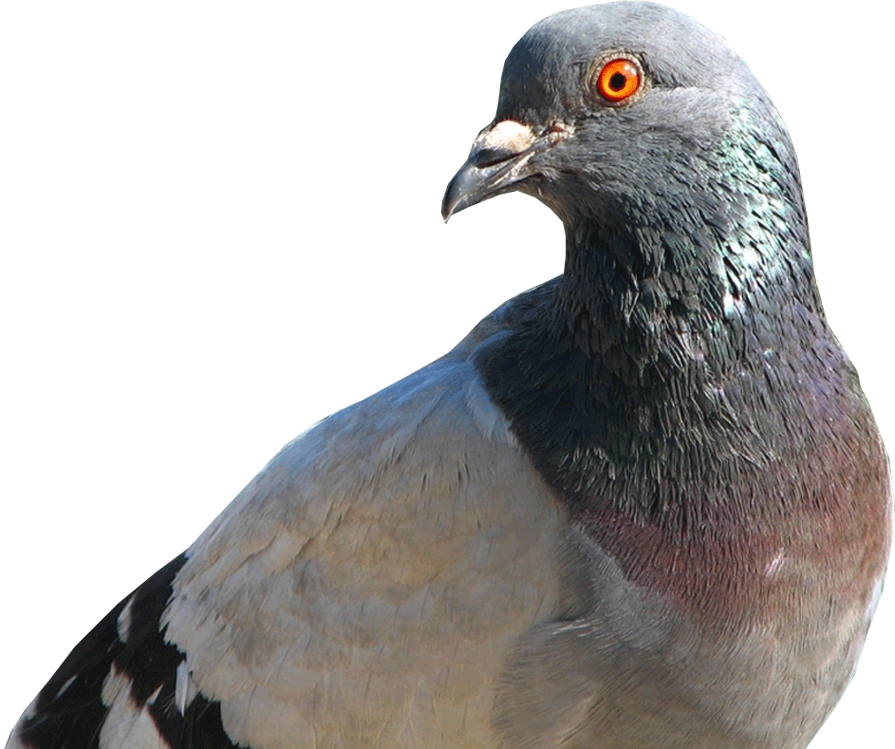
Sources of Delay: Propagation Delay
Propagation delay can be much larger in other supported medium
Request for Comment (RFC) 1149 defines the IPoAC protocol
IP over Avian Carriers
IPoAC was published as an April Fools joke, but it actually has been implemented!
In 2001, the Bergen Linux group successfully transmitted 9 packets over a distance of 5 km. The average latency was 5222806 ms...

Slide 12

Sources of Delay: Propagation Delay
Propagation delay can be much larger in other supported medium
Request for Comment (RFC) 1149 defines the IPoAC protocol
IP over Avian Carriers
IPoAC was published as an April Fools joke, but it actually has been implemented!
In 2001, the Bergen Linux group successfully transmitted 9 packets over a distance of 5 km. The average latency was 5222806 ms…
Higher than average risk of dropped packets...

Slide 13
Sources of Delay: Processing Delay
Your Computer
Router
P1
Processing (or store-and-forward) delay is the time for the receiving device to read and process the packet
Delay is usually negligible, typically microseconds
Delay comes from checking for bit-level errors, routing the packet, and storing the packet for forwarding
d_{process} can’t be solved for using a simple equation

Slide 14
Store and Forward
A router has to wait until it has received the whole packet before it can begin forwarding it
Why does it have to wait? Why not just forward bits as they come in?

Slide 15
Store and Forward
A router has to wait until it has received the whole packet before it can begin forwarding it
Why does it have to wait? Why not just forward bits as they come in?
The router doesn’t know where to send the packet until the packet has arrived! That information is contained within the packet

Slide 16
Store and Forward
A router has to wait until it has received the whole packet before it can begin forwarding it
Why does it have to wait? Why not just forward bits as they come in?
The router doesn’t know where to send the packet until the packet has arrived! That information is contained within the packet
Because of this, routers need a dedicated buffer to store packets before forwarding them
This also introduces additional transmission latency, as each router has to retransmit the packet

Slide 17
Sources of Delay: Queuing Delay
Your Computer
Router
P31
P82
P1
Queuing delay is the time the packet spends waiting to be transmitted because the outgoing link is busy
d_{queue} is variable and depends on how much other traffic is present on the network, ranges from 0 to ∞

Slide 18
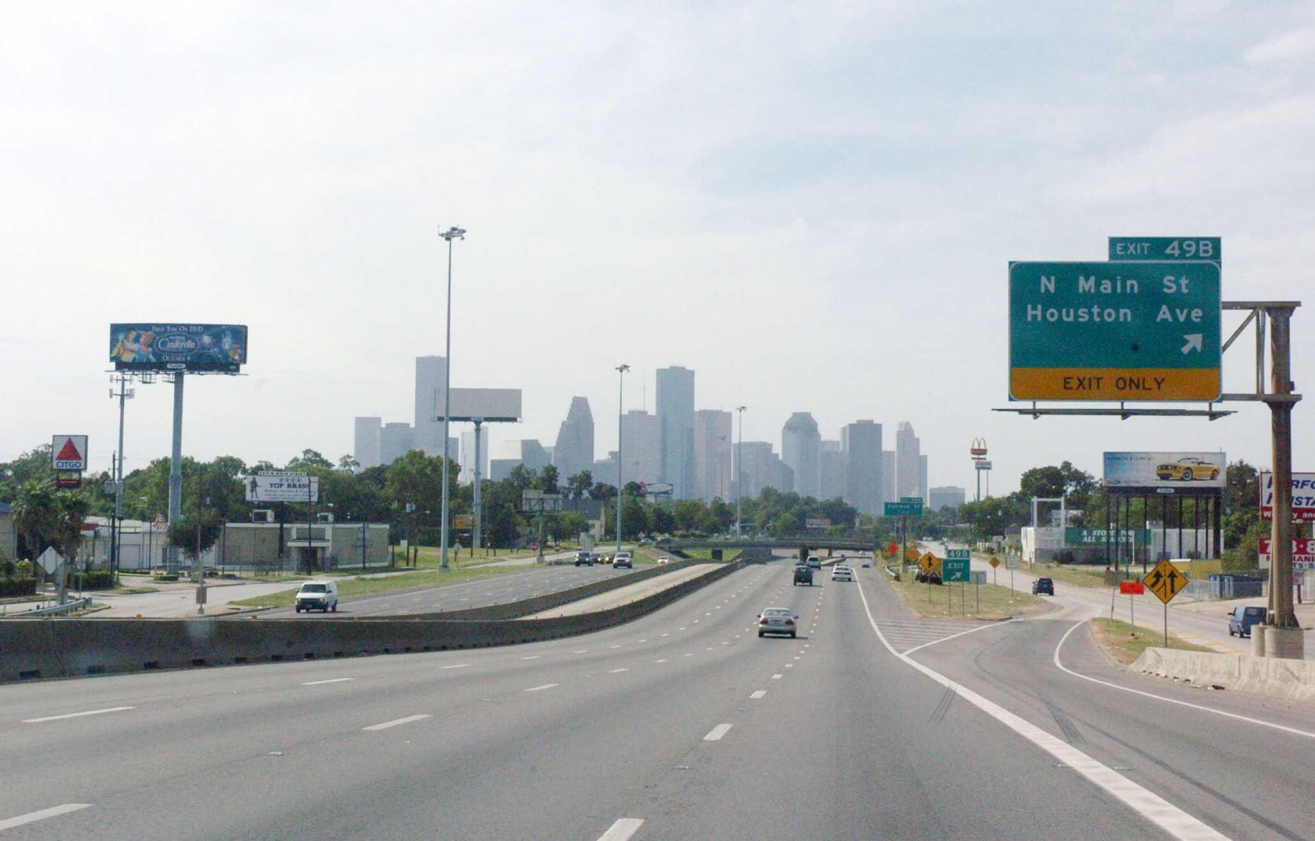
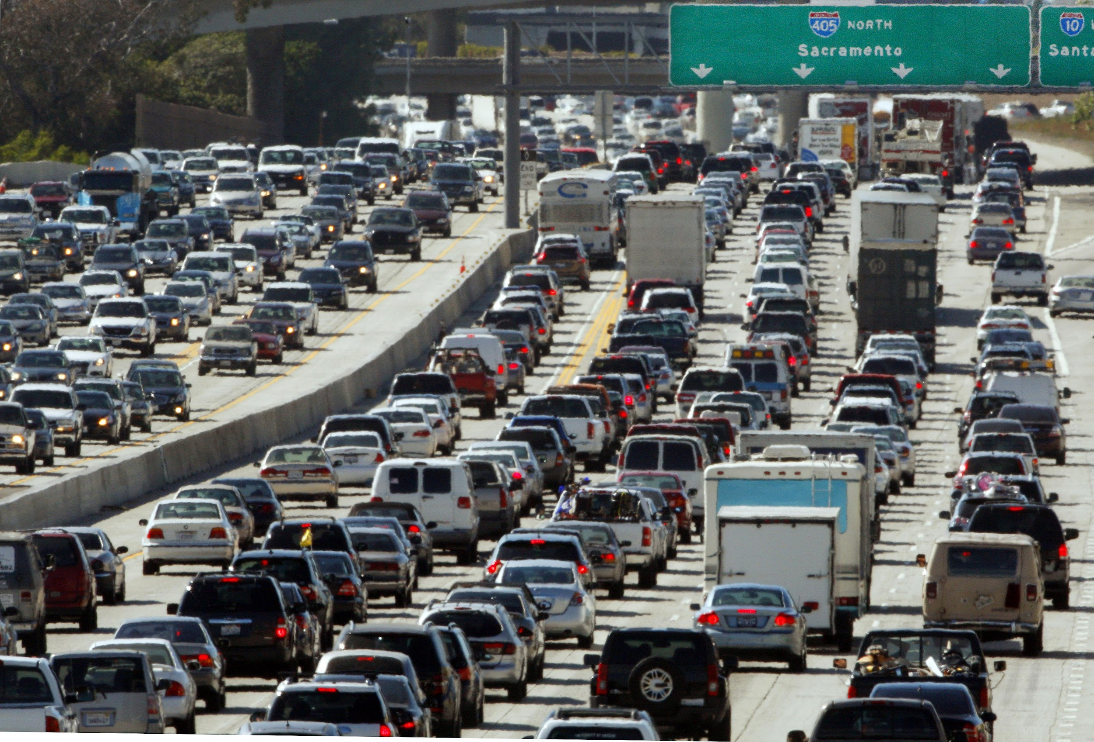
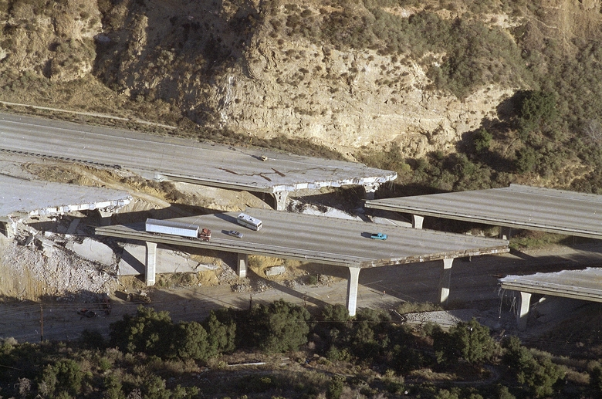
Queuing Delay
Queueing delay ~ L/R
L = packet length (bits)
R = link bandwidth (bits/sec)
a = average packet arrival rate
L*a/R ~ 0 → avg queueing delay is small
L*a/R ~ 1 → avg queueing delay is large
L*a/R > 1 → avg queueing delay is ∞
L*a/R ~ 0
L*a/R ~ 1
L*a/R > 1

Slide 19
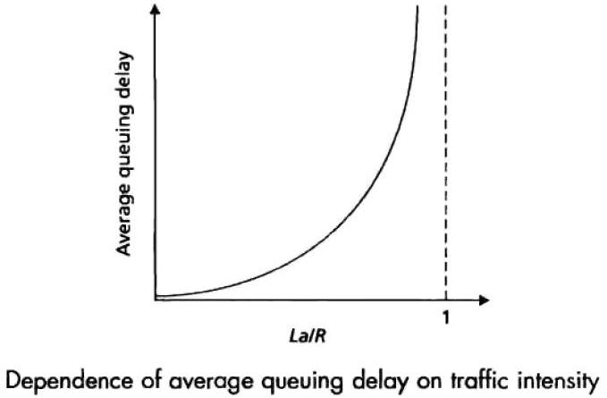

Slide 20
Infinite Delay?
Why does our queuing delay approach infinity when the average incoming data exceeds the outgoing link capacity?
It approaches infinity over time, not immediately upon entering this state

Slide 21
Infinite Delay?
Why does our queuing delay approach infinity when the average incoming data exceeds the outgoing link capacity?
It approaches infinity over time, not immediately upon entering this state
Delay approaches infinity because the receiving buffer grows infinitely
Because of store-and-forward, routers have to buffer incoming packets
When L*a/R > 1, this buffer grows faster than it can be emptied
In the real world, this results in dropped packets. If a packet is received when the buffer is full, the router has to throw it away

Slide 22
Queuing Delay Simulation
https://media.pearsoncmg.com/aw/ecs_kurose_compnetwork_7/cw/content/interactiveanimations/queuing-loss-applet/index.html

Slide 23
Review
There are four sources of latency in the Internet
Transmission delay: time needed to push data onto the “wire”
Propagation delay: time needed for data to travel on the “wire”
Processing delay: time needed by a router to process and route data
Queuing delay: time spent waiting in line to be transmitted
Store-and-forward requires packets to be buffered at each router until the entire packet is received
Queuing delay is the most variable source of delay, and the cause of most problematic latency on normal networks

Slide 24
Transmission + Propagation Delay
We’ll use the example of cars traveling on a toll road for this example
Assume the following
Cars travel in caravans
Each caravan represents 1 packet, each car 1 bit
Cars can’t pass through the toll booth until their whole caravan has arrived
Represents the store-and-forward process used when processing packets
Passing through the toll booth == a bit has been transmitted by a router

Slide 25
Terminology
Mbps vs. MBps
Lowercase b = bits
Uppercase B = bytes
8 Mbps = 1 MBps
For this course, we will assume:
1 Kb = 1000 bits
1 Mb = 1000 Kb
1 Gb = 1000 Mb
...

Slide 26
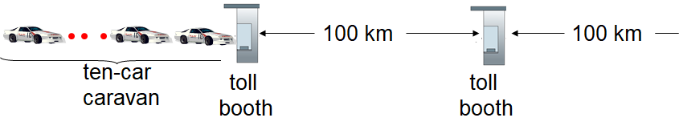
Example 1: Transmission + Propagation Delay
How long till the caravan is lined up at the 3rd toll booth?
10 cars in a caravan
I.e. L = 10 bits
Toll booths require 12 seconds to service a car
i.e. R = 1/12 bit/sec
Cars travel at 100 km/h
I.e. s_{prop} = 100 km/h
10 km

Slide 27
Example 1: Transmission + Propagation Delay
How long till the caravan is lined up at the 3rd toll booth?
L = 10 bits
R = 1/12 bit/sec
s_{prop} = 100 km/h
10 km

Slide 28
Example 2: Transmission + Propagation Delay
How long till the caravan is lined up at the 3rd toll booth?
10 cars in a caravan
I.e. L = 10 bits
Toll booths require 1 minute to service a car
i.e. R = 1/60 bit/sec
Cars travel at 1000 km/h
I.e. d_{prop} = 1000 km/h
10 km

Slide 29
Example 2: Transmission + Propagation Delay
How long till the caravan is lined up at the 3rd toll booth?
L = 10 bits
R = 1/60 bit/sec
d_{prop} = 1000 km/h
10 km

Slide 30
Example 3: Transmission + Propagation Delay
How many cars will still be at the first booth when the first car arrives at the second booth?
L = 10 bits
R = 1/60 bit/sec
d_{prop} = 1000 km/h

Slide 31
Transmission + Propagation + Queuing Delay
How can queuing delay be added to this analogy?

Slide 32
Transmission + Propagation + Queuing Delay
How can queuing delay be added to this analogy?
Multiple caravans are traveling on the road. If you arrive when a caravan is already lined up, you have to wait for it to go through first

Slide 33
Transmission + Propagation + Queuing Delay
How can queuing delay be added to this analogy?
Multiple caravans are traveling on the road. If you arrive when a caravan is already lined up, you have to wait for it to go through first
Queuing time is variable, depending on how many other caravans are already here
We can’t easily calculate queuing time the way we can calculate transmission and propagation delay
We can however get a rough idea of if it will be small, large, or infinite

Slide 34
“Real” Internet delays and routes
What do “real” Internet delays look like?
The traceroute program measures delay from source to router along end-to-end paths to the destination
For all i:
Send three packets that will reach each router i along path to destination
Router i will return packets to sender
Sender times interval between transmission and reply
http://traceroute.org

Slide 35
Traceroute to http://www.clemson.edu (130.127.204.30), 30 hops max, 40 byte packets 1 core-87-router (128.112.128.2) 1.103 ms 0.643 ms 0.453 ms 2 border-87-router (128.112.12.142) 0.947 ms 0.718 ms 0.653 ms 3 local1.princeton.magpi.net (216.27.98.113) 1.944 ms 2.771 ms 1.914 ms 4 216.27.100.18 (216.27.100.18) 2.183 ms 2.162 ms 2.027 ms 5 et-1-1-0.4079.rtsw.wash.net.internet2.edu (162.252.70.119) 5.796 ms 5.933 ms 5.639 ms 6 et-5-0-0.4079.rtsw.rale.net.internet2.edu (162.252.70.120) 10.592 ms 10.635 ms 14.369 ms 7 205-186-224-49.generic.sclightrail.net (205.186.224.49) 16.098 ms 16.294 ms 16.170 ms 8 * * * 9 205-186-62-89.generic.c-light.net (205.186.62.89) 19.316 ms 19.462 ms 20.118 ms 10 205-186-62-88.generic.c-light.net (205.186.62.88) 19.315 ms 19.799 ms 19.000 ms 11 130.127.3.186 (130.127.3.186) 20.691 ms 20.787 ms 130.127.3.185 (130.127.3.185) 20.982 ms 12 130.127.3.152 (130.127.3.152) 20.321 ms 20.248 ms 130.127.3.64 (130.127.3.64) 20.626 ms 13 130.127.3.102 (130.127.3.102) 20.676 ms 130.127.204.30 (130.127.204.30) 20.641 ms 130.127.3.102 (130.127.3.102) 20.733 ms

Slide 36
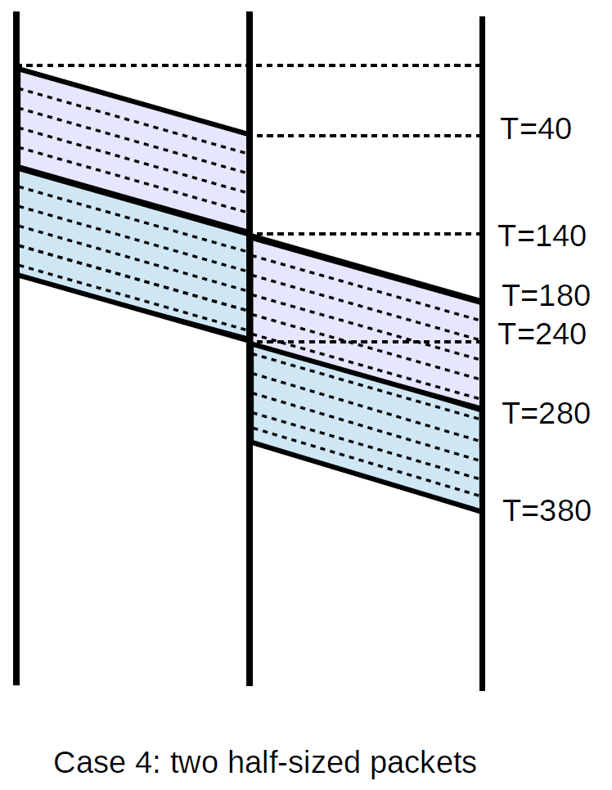
Ladder Diagrams
Link 1
Link 2
Illustrate how packets travel over time
Here we see two packets, crossing two links
Horizontal regions illustrate a packet crossing a link
Height of the region is the transmission time
Slope of the region linked to propagation time
First packet has took 100ms to transmit, 40ms to propagation
Second packet started sending at 100ms, arrived at destination at 380ms
We may sometimes ignore transmission time

Slide 37
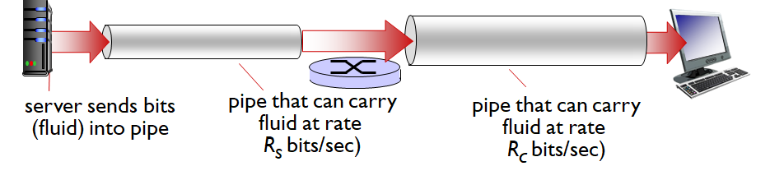
Throughput
Bandwidth is the amount of data that CAN be transmitted per second
Throughput is the amount of data that IS transmitted per second
Can be measured instantaneously, or on average
Goodput is the amount of USEFUL data transmitted per second

Slide 38
Throughput
Assuming R_{s} < R_{c}, what is the average end-to-end throughput?

Slide 39
Throughput
Assuming R_{s} < R_{c}, what is the average end-to-end throughput?
Average throughput is R_{s}, as this pipe limits the network

Slide 40
Throughput
Assuming R_{s} > R_{c}, what is the average end-to-end throughput?

Slide 41
Throughput
Assuming R_{s} > R_{c}, what is the average end-to-end throughput?
Average throughput is R_{c}, as this pipe limits the network

Slide 42
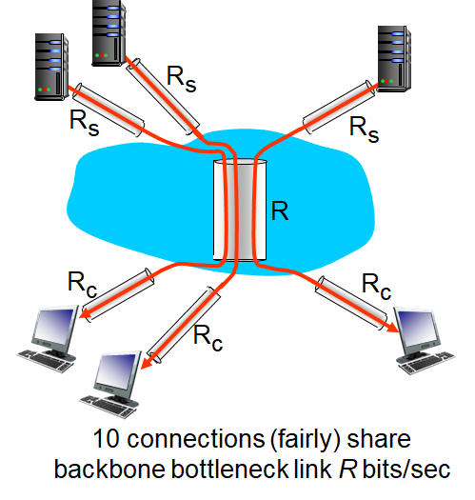
Throughput: Bottlenecks
In reality, many packets share the network simultaneously
The bottleneck link is the link on the end-to-end path that constrains throughput

Slide 43
Throughput: Bottlenecks
In reality, many packets share the network simultaneously
The bottleneck link is the link on the end-to-end path that constrains throughput
Assume 10 connections are fairly sharing R
Each can use R/10 bits/sec
What is per-connection end-to-end throughput?

Slide 44
Throughput: Bottlenecks
In reality, many packets share the network simultaneously
The bottleneck link is the link on the end-to-end path that constrains throughput
Assume 10 connections are fairly sharing R
Each can use R/10 bits/sec
What is per-connection end-to-end throughput?
min(R_{c}, R_{s}, R/10)
In practice, R_{c} or R_{s} is usually the bottleneck

Slide 45
Throughput
IPoAC has very high propagation delay.
Does that mean it also has low throughput?

Slide 46

Throughput
IPoAC has very high propagation delay.
Does that mean it also has low throughput?
Not necessarily!
If the pigeons carry high density SD cards, they could actually have very high throughput
Latency and throughput are not necessarily related to each other

Slide 47
Review
Throughput is a measure of how much data is transmitted per second
Bandwidth is the theoretical maximum throughput
Goodput is the amount of useful data transmitted per second. This ignores errors, retransmitted data, etc
The maximum throughput between two edge nodes is limited by the connecting link with the lowest throughput
Throughput is not necessarily correlated with latency

Slide 48
Errors
Sources of error in a network
Corrupted packets
Dropped packets
Misordered packets
Collisions

Slide 49
Corrupted Packets
Packets may sometimes be corrupted in flight
E.g. bits that are transmitted are received differently
Ex. 010101 → 000101
If this happens, it’s usually not possible to tell which bit(s) were flipped, so we have to throw away the packet

Slide 50
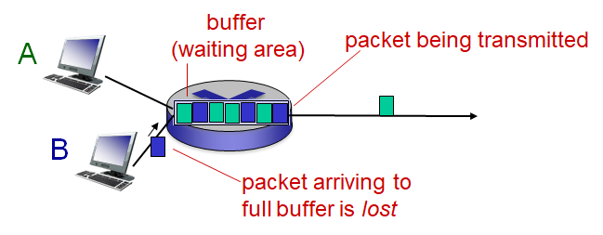
Dropped packets
Packet queues have finite capacity
Possible to have a packet arrive but not have space for it
The packet is then dropped (i.e. lost)
Lost packets may be retransmitted from the previous node, by the origin node, or not at all
Corrupted packets also get dropped, but not because of a buffer overflow

Slide 51
Misordered Packets
Applications want data sent, not packets
Network system breaks data into packets for efficiency
E.g. tearing up a book so that if fits in standard envelopes
Packets need to be received in the same order they are sent, or the data can’t be reconstructed correctly
If a packet is received out of order, the system may not know what to do with it, and may drop the packet

Slide 52
Collisions
A collision occurs when two or more hosts attempt to transmit on the same media at the same time
E.g. In cable internet, a single coaxial cable is shared by multiple homes. Each home taps into the same backbone cable, which connects to the ISP. As such, if multiple homes attempt to communicate to the ISP simultaneously, this means their signals are on the cable at the same time, and can’t be separated from each other
When a collision happens, both packets are dropped and a mechanism is triggered to retransmit the packets, hopefully without a collision
Collisions are impossible on non-shared media (e.g. Ethernet cables)

Slide 53
Review
Several errors can occur with a single transmission
Corrupted packets
Dropped packets (either due to buffer overflow, or corruption)
Misordered packets
An additional error can occur in shared lines
Collisions occur when multiple users attempt to transmit simultaneously on a single shared line

Slide 54
Before next class
Beginning Python in class, install:
Python 3 (Anaconda Installer recommended)
IDE (Visual Studio Code recommended)
A development environment is REQUIRED to debug your project
See TA for any problems with setting up Python or the IDE
Complete the first practice activity (on Canvas) by Monday at midnight

